Slide 1
Trade Liberalization and Labor-Market Gains: Evidence from US Matched Employer-Employee Data
Justin R. Pierce Board of Governors, U.S. Federal Reserve
Peter K. Schott Yale School of Management & NBER & CEPR
Cristina Tello-Trillo U.S. Census Bureau October 2023

Slide 2
Disclaimer
The views expressed in the paper are those of the authors and not necessarily those of the U.S. Census Bureau. The Census Bureau's Disclosure Review Board and Disclosure Avoidance Officers have reviewed this data product for unauthorized disclosure of confidential information and have approved the disclosure avoidance practices applied to this release. DRB Approval Numbers CBDRB-FY21-CES006-002, CBDRB-FY21-327 and CBDRB-FY22-CES020-001.

Slide 3
Motivation
Many papers in labor and trade examine impact of labor-market shocks
Lots of attention on “China shock”, but questions remain:
Disagreement on earnings impact within/outside manufacturing
Where do displaced manufacturing workers go?
Why no pro-competitive effects?
We re-visit the US granting of PNTR to China using employer-employee data
Impact of county versus industry exposure?
Outcomes in- versus outside manufacturing?
Effect of up- and downstream exposure?
Differences among high- versus low-tenure?
Variation in outcomes by worker and firm attributes?
Notes:
11-12:15pm
Hakobyan and Mclaren look at NAFTA: they find the lowest educated are hurt
Autor et al look at Chinese import penetration over a long difference, 1992-07; they look only at the direct effect on workers long-term earnings an employment
Dix Carneiro and Kovak (2017) e “regional tariff reduction” look at workers exposure to tariff declines based on their regions’ exposure to these declines.
following the Brazilian trade liberalization of the early 1990s. Using 25 years of data they find large and growing effects of trade liberalization on regional formal
earnings and employment, main reason lack of labor mobility.
Devlin kovak morrow: This paper uses matched longitudinal administrative data for Canadian workers during 1984-2004 to assess the long-run effects of the 1988 Canada-U.S. Free Trade Agreement (CUSFTA) onthe Canadian labor market. No cumulative long-terms effects, increase export expansion accompanied by import competition, in the short term they do see increase in separations (out of the labor force) long term no big effects, earnings fo back to normal.
For workers initially in man-ufacturing industries that experienced Canadian concessions, we find a heightened probability ofwork-shortage based separations at large firms but little impact on long-run cumuilative earnings.Lower cumulative earnings at the initial employer are offset by gains outside manufacturing. ForCanadian workers in industries that obtained U.S. concessions, we find a lower probability of sep-aration and higher cumulative earnings. These effects are concentrated among workers initiallyemployed in larger firms, and there are important differences between low and high attachmentworkers.
All of these papers are a bit different: We look at a specific trade liberalization like T, HM, DCK but look at China’s impact on US like Autor. Unlike Autor but like HM we look at the impact at different levels or education. Unlike Autor, we look specific trade liberalization.
so, why does this matter?
Isn’t what we find obvious?
Are we trying to recover frictions?
This paper extends the literature on labor market impacts of trade by shifting the focus from aggregate market level reactions to adjustments at the worker level. We will be able to quantify the distribution of incidence among workers along two margins, industry and county margin. ADHS (2014) are able to measure worker-level consequences by focusing on the substantial differences in trade exposure that derive from the initial industry of employment (but not location). We are able to decompose the magnitude of both, the initial industry of employment and also the location of employment. Our 5% extract of the LEHD (for large counties) and 100% extract for small counties provides a more precise measurement of local industry composition.
AHD (2013) is aout changes in employments and average earnings across U.S. local labor markets (CZ) resulting from regiona exposure from import competition from China. That work used repeated cross sections (CBP) on geographic localities it cannot address how individuals adjust to trade schoks.

Slide 4
Key Findings/Contributions
County exposure matters more than industry exposure
Upstream exposure mitigates own and downstream exposure
Exposed M workers exhibit large relative earnings losses
NM workers gains from upstream exposure offset losses from own and downstream exposure, inducing relative earnings gains
M workers at smaller, non-diversified, trading firms do relatively well
M and NM workers within initially high earnings to relatively well

Slide 5
Related Literatures An incomplete list!
Mass layoffs: Jacobson et al. (1993), Von Wachter and Davis (2011), Hummels et al. (2014), etc.
Spatial and labor market frictions: Topel (1986), Blanchard and Katz (1992), Glaeser and Gyourko (2005), etc., Traiberman (2019), Caliendo et al. (2019), Dauth et al (2017), etc.
Import shocks: Topolova (2007), Kovak (2013), Hakobyan and Mclaren (2016), Dix-Carneiro and Kovak (2017), Kovak and Morrow (2020), etc.
China shock: Ebenstein et al. (2011), Autor et al. (2013, 2014), Pierce and Schott (2016), Acemoglu et al. (2016), Bloom et al. (2019); Hurst et al (2019), etc, Carballo and Mansfield (2023)

Slide 6
Existing China Shock Evidence is Mixed
Manufacturing
Non-Manufacturing
i region^{own} (ADH 2013)
0 region^{own} (ADH 2013)
Employment
i region^{own} (BHKL 2019)
h high-skill region^{own} (BHKL 2016)
i region^{own} region^{down} (AADHP 2016)
i region^{own} region^{down} (AADHP 2016)
i industry^{own} industry^{down} (AADHP 2016)
i industry^{own} industry^{down} (AADHP 2016)
i industry^{own} industry^{down} (PS 2016)
0 region^{own} (ADH 2013)
i region^{own} (ADH 2013)
Wages
i low-skill region^{own} (BHKL 2016)
i low-skill region^{own} (BHKL 2016)
h high-skill region^{own} (BHKL 2016)
h high-skill region^{own} (BHKL 2016)
i region^{own} industry^{own} (ADHS 2014)

Slide 7
Existing China Shock Evidence is Mixed
Manufacturing
Non-Manufacturing
Employment
Wages

Slide 8
Existing China Shock Evidence is Mixed
Manufacturing
Non-Manufacturing
i region^{own} (ADH 2013)
Employment
i region^{own} (BHKL 2019)
i region^{own} region^{down} (AADHP 2016)
i industry^{own} industry^{down} (AADHP 2016)
i industry^{own} industry^{down} (PS 2016)
M employment declines found in all studies
Wages

Slide 9
Existing China Shock Evidence is Mixed
Manufacturing
Non-Manufacturing
i region^{own} (ADH 2013)
0 region^{own} (ADH 2013)
Employment
i region^{own} (BHKL 2019)
h high-skill region^{own} (BHKL 2016)
i region^{own} region^{down} (AADHP 2016)
i region^{own} region^{down} (AADHP 2016)
i industry^{own} industry^{down} (AADHP 2016)
i industry^{own} industry^{down} (AADHP 2016)
i industry^{own} industry^{down} (PS 2016)
M employment declines found in all studies
NM employment results are mixed
Wages

Slide 10
Existing China Shock Evidence is Mixed
Manufacturing
Non-Manufacturing
i region^{own} (ADH 2013)
0 region^{own} (ADH 2013)
Employment
i region^{own} (BHKL 2019)
h high-skill region^{own} (BHKL 2016)
i region^{own} region^{down} (AADHP 2016)
i region^{own} region^{down} (AADHP 2016)
i industry^{own} industry^{down} (AADHP 2016)
i industry^{own} industry^{down} (AADHP 2016)
i industry^{own} industry^{down} (PS 2016)
M employment declines found in all studies
NM employment results are mixed
0 region^{own} (ADH 2013)
i region^{own} (ADH 2013)
Wages
i low-skill region^{own} (BHKL 2016)
i low-skill region^{own} (BHKL 2016)
h high-skill region^{own} (BHKL 2016)
h high-skill region^{own} (BHKL 2016)
i region^{own} industry^{own} (ADHS 2014)
Wage results are mixed

Slide 11
Existing China Shock Evidence is Mixed
Manufacturing
Non-Manufacturing
i region^{own} (ADH 2013)
0 region^{own} (ADH 2013)
Employment
i region^{own} (BHKL 2019)
h high-skill region^{own} (BHKL 2016)
i region^{own} region^{down} (AADHP 2016)
i region^{own} region^{down} (AADHP 2016)
i industry^{own} industry^{down} (AADHP 2016)
i industry^{own} industry^{down} (AADHP 2016)
i industry^{own} industry^{down} (PS 2016)
M employment declines found in all studies
NM employment results are mixed
0 region^{own} (ADH 2013)
i region^{own} (ADH 2013)
Wages
i low-skill region^{own} (BHKL 2016)
i low-skill region^{own} (BHKL 2016)
h high-skill region^{own} (BHKL 2016)
h high-skill region^{own} (BHKL 2016)
i region^{own} industry^{own} (ADHS 2014)
Wage results are mixed
Bloom et al. focus on regional skill abundance
Our results with respect to supply chain exposure provide mechanism for that result

Slide 12
Outline
Introduction
Data
Reallocation after PNTR
PNTR and earnings
Heterogenous impacts
Alternate specifications
Conclusion

Slide 13
Data
LEHD: Longitudinal Employer-Household Dynamics Database
Based on state UI records, 1993-2014
State availability depends on time period
Quarterly earnings (gross salaries+bonuses+tips) and employment
Worker demographics: gender, age, race, ethnicity, education
Workers matched to establishments
LBD: Longitudinal Business Database
Establishments matched to NAICS codes and firms
Establishment and firm characteristics (e.g., size, diversification)
LFTTD: Longitudinal foreign trade transactions database
Firms matched to import and export transactions
Notes:
CA, FL, PA are there…

Slide 14
LEHD Samples
The number of states available in the LEHD increases over time
We make use of two extracts
2000-2007: 46-states: examine overall MnNM reallocation
1993-2014: 19-state sample: DID regressions

Slide 15
Outline
Introduction
Data
Reallocation after PNTR
PNTR and earnings
Heterogenous impacts
Alternate specifications
Conclusion

Slide 16
Where did all the manufacturing workers go?

Slide 17
MnNM Transitions, 2000g2007 46 State Sample

Slide 18
MnNM Transitions, 2000g2007 46 State Sample
M employment falls from 18.3 to 15.4 million

Slide 19
MnNM Transitions, 2000g2007 46 State Sample
M employment falls from 17.5 to 14 million
Large gross flows to and from M!

Slide 20
MnNM Transitions, 2000g2007 46 State Sample
M employment falls from 17.5 to 14 million
Large gross flows to and from M!
Large gross flows to and from NE!

Slide 21
MnNM Transitions, 2000g2007 46 State Sample
M employment falls from 17.5 to 14 million
Large gross flows to and from M!
Large gross flows to and from NE!
Where did the 5.8 million M workers go?

Slide 22
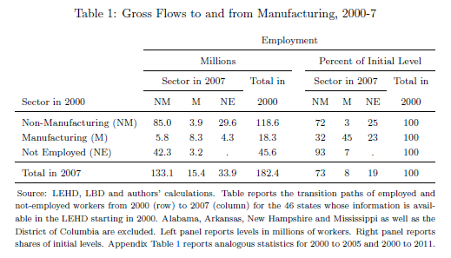

Slide 23
Gross Flows out of M, 2000g2007 45% stay in M, 23%gNE

Slide 24
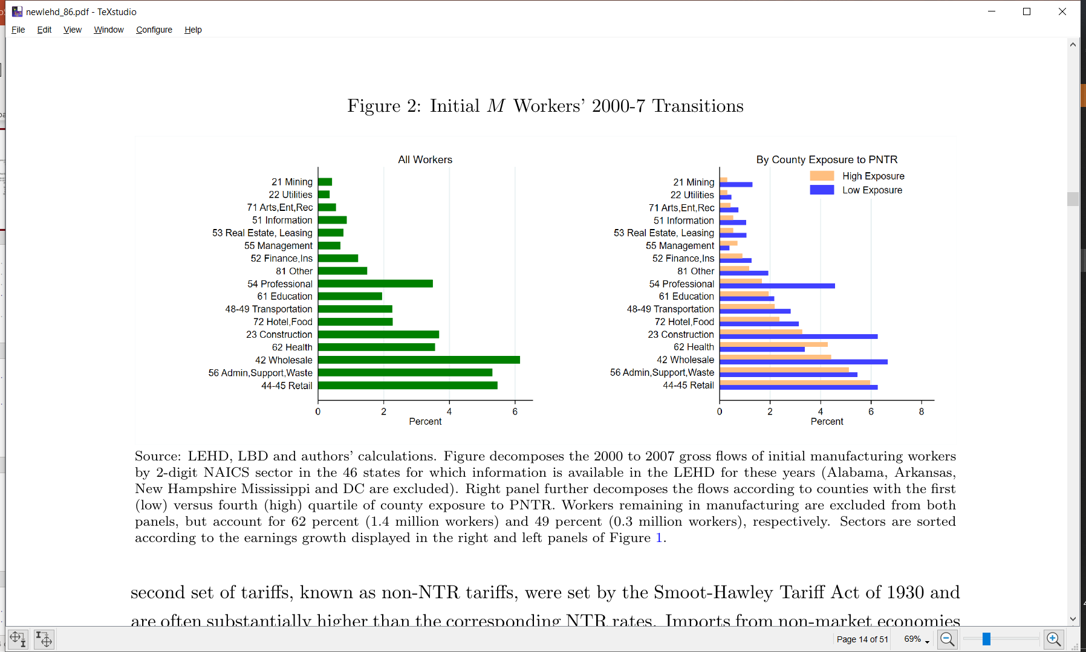
Gross Flows out of M, 2000g2007 45% stay in M, 23%gNE
Change of industry but not occupation, or
structural change?
Charles et al. (2015)
Outsourcing to temp agencies?
Percent of Gross Flow from M to NM, 2000-2007

Slide 25
Gross Flows out of M, 2000g2007

Slide 26
Gross Flows out of M, 2000g2007 (In Levels)

Slide 27
Gross Flows out of M, 2000g2007
Moves to professional, wholesale and construction are more likely in LESS exposed areas
Move to health more likely in MORE exposed areas

Slide 28
Median Worker-Level ΔEarnings by Transition Path 2000g2007

Slide 29
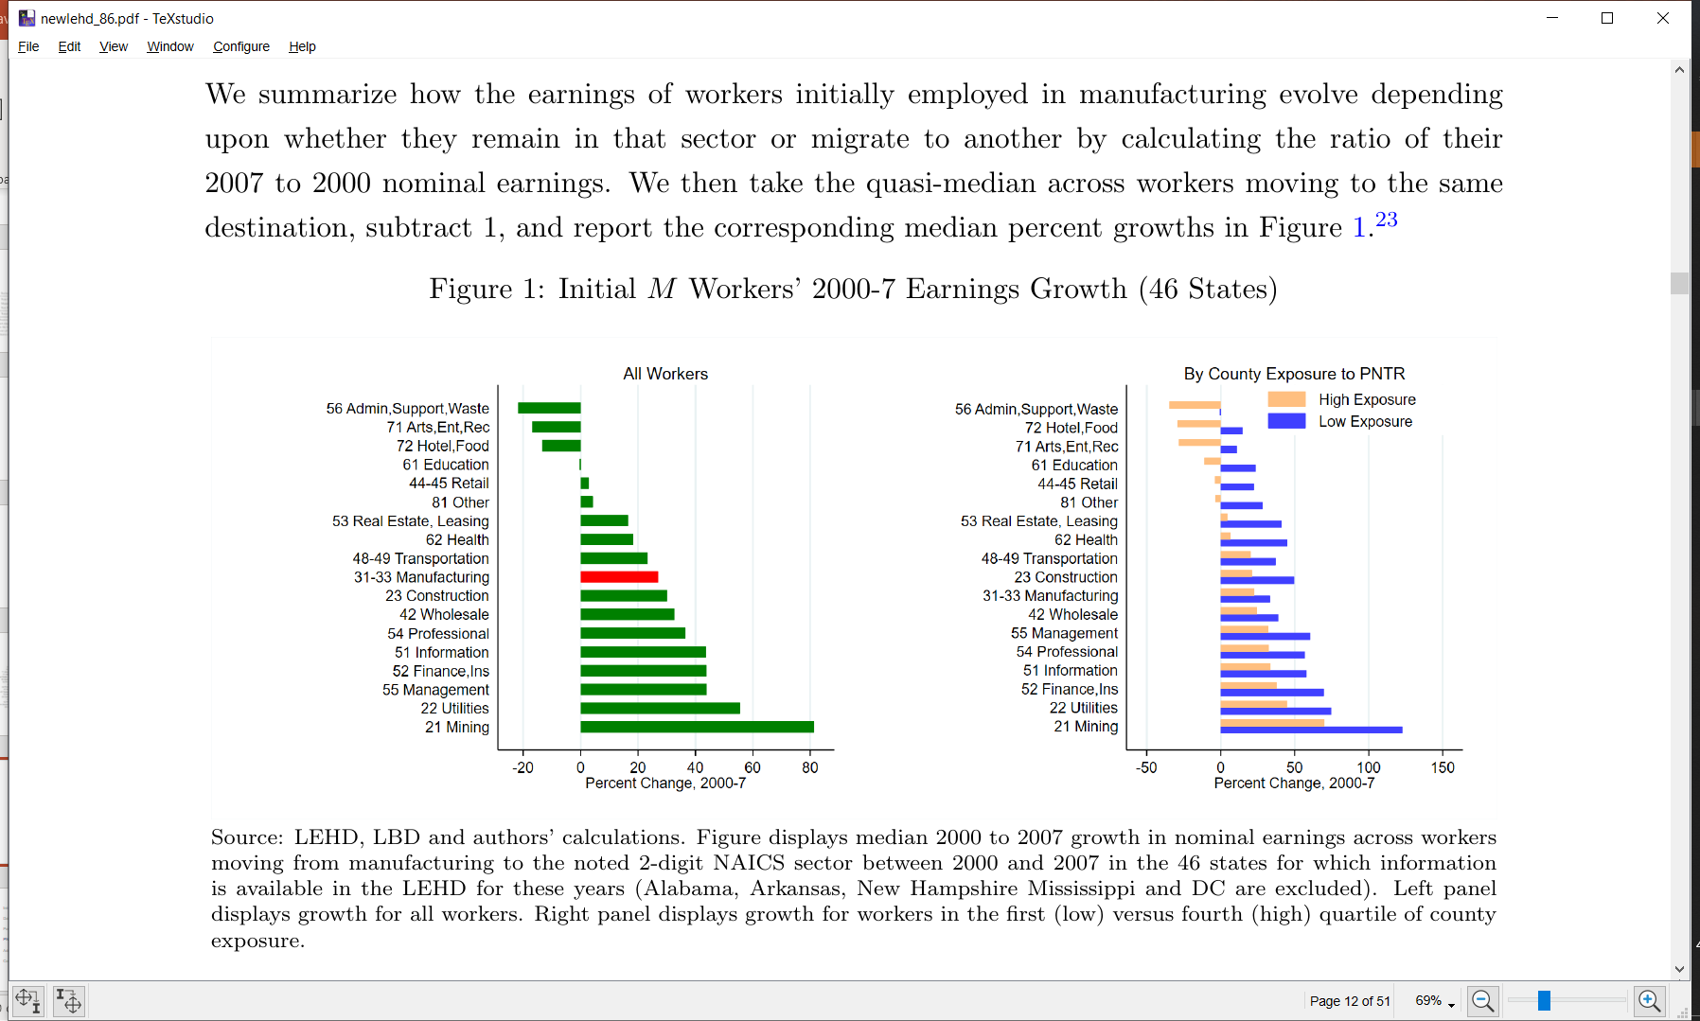
Median Worker-Level ΔEarnings by Transition Path 2000g2007
Nominal earnings fall among those transitioning to less skill-intensive service sectors
Nominal earnings growth among those staying in M is ~3% per year

Slide 30
Median Worker-Level ΔEarnings by Transition Path 2000g2007
Median earnings growth universally lower with higher exposure

Slide 31
Outline
Introduction
Data
Reallocation after PNTR
PNTR and earnings: direct specification
PNTR and earnings: IO specification
Heterogenous impacts
Alternate specifications
Conclusion

Slide 32
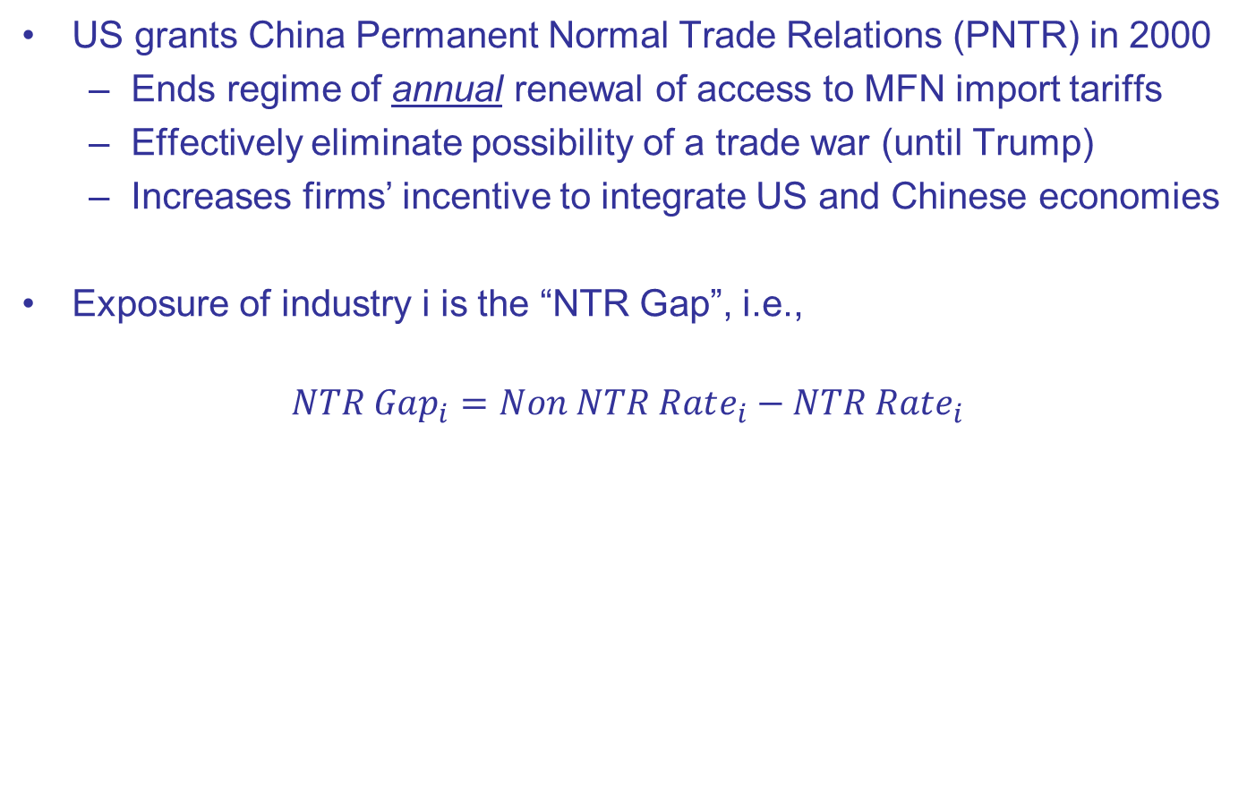
PNTR
US grants China Permanent Normal Trade Relations (PNTR) in 2000
Ends regime of annual renewal of access to MFN import tariffs
Effectively eliminate possibility of a trade war (until Trump)
Increases firms’ incentive to integrate US and Chinese economies
Exposure of industry i is the “NTR Gap”, i.e.,
$$NTR Gap_{i}=Non NTR Rate_{i}−NTR Rate_{i}$$
High Tariff Rate If Annual Renewal Fails
Low Tariff Rate Under Annual Renewal
Notes:
Industry exposure captures industry switching costs
County exposure captures spatial moving costs

Slide 33

Two Dimensions of Exposure
Industry Exposure: captures industry-switching frictions
$$NTR Gap_{i}=Non NTR Rate_{i}−NTR Rate_{i}$$
County Exposure: captures spatial frictions
$$NTR Gap_{c}=\sum_{i}{\frac{Emp_{ic}^{1990}}{Emp_{c}^{1990}}NTR Gap_{i}}$$
Notes:
Industry exposure captures industry switching costs
County exposure captures spatial moving costs

Slide 34
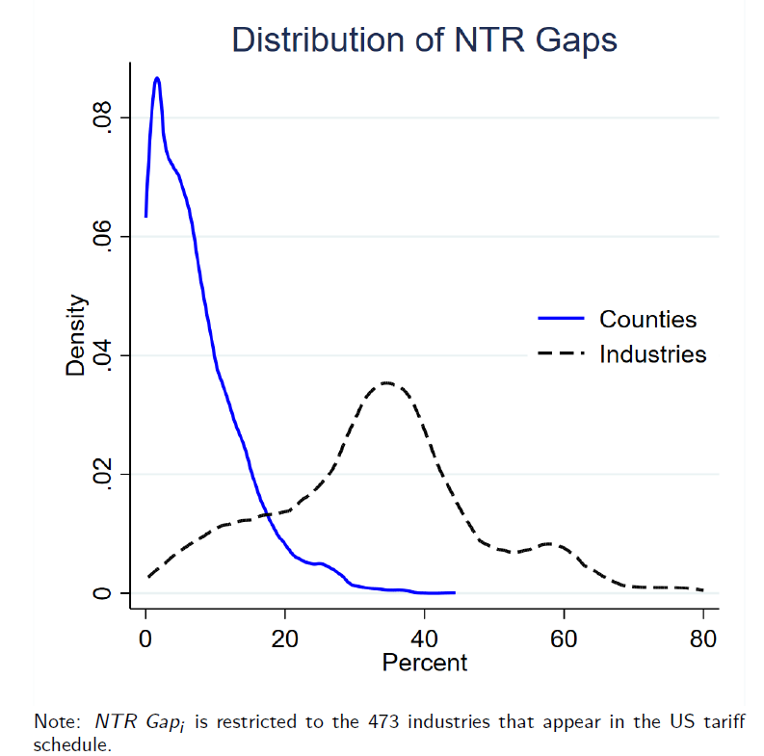
(All)
(M Only)
Notes:
75-25 interuartiles is around 20

Slide 35
Regression Samples
19 states have data available before and after PNTR (1993-2014)
Construct 5% random stratified sample on non-retirees
Age<64 in 2014
Sample has >1M workers, >200K firms
20% of worker are initially at M firms; 80% at initial NM firms
Focus on “High-tenure” (HT) workers
Employed by same firm between 1993 to 1999
Assume lots of firm-specific human capital
Also consider “Low-tenure” (LT) workers (in paper)
Employed (earnings>0) 1993 to 1999

Slide 36
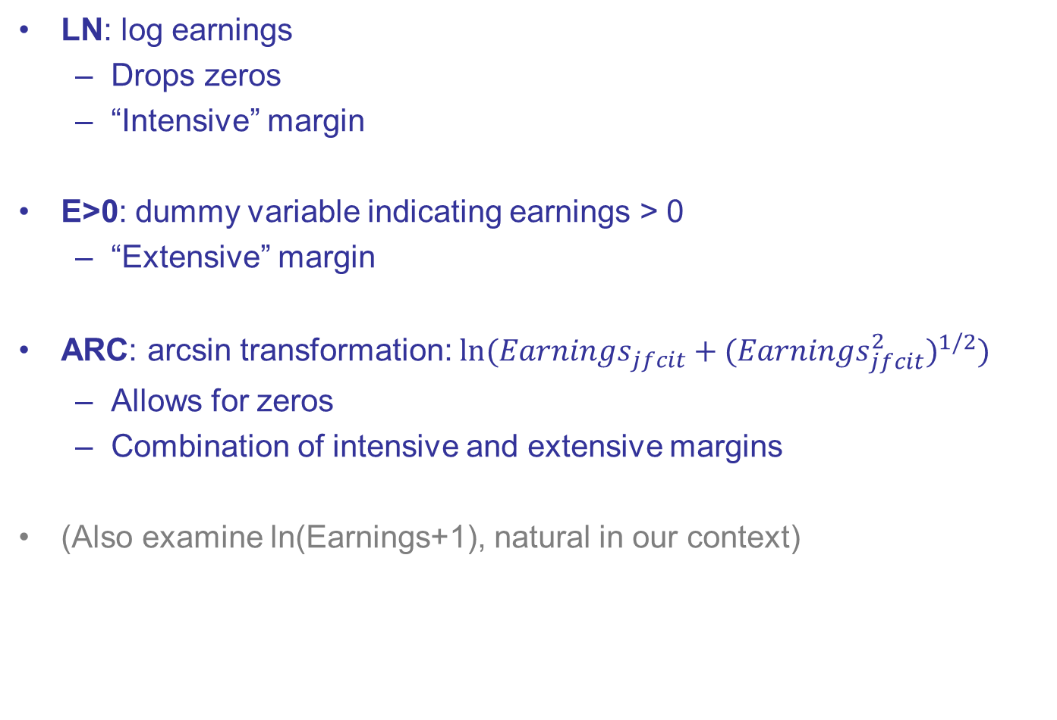
Earnings Outcomes worker j, firm f, county c, industry i, year t
LN: log earnings
Drops zeros
“Intensive” margin
E>0: dummy variable indicating earnings > 0
“Extensive” margin
ARC: arcsin transformation: $ln⁡({Earnings}_{jfcit}+{({Earnings}_{jfcit}^{2})}^{1/2})$
Allows for zeros
Combination of intensive and extensive margins
(Also examine ln(Earnings+1), natural in our context)

Slide 37
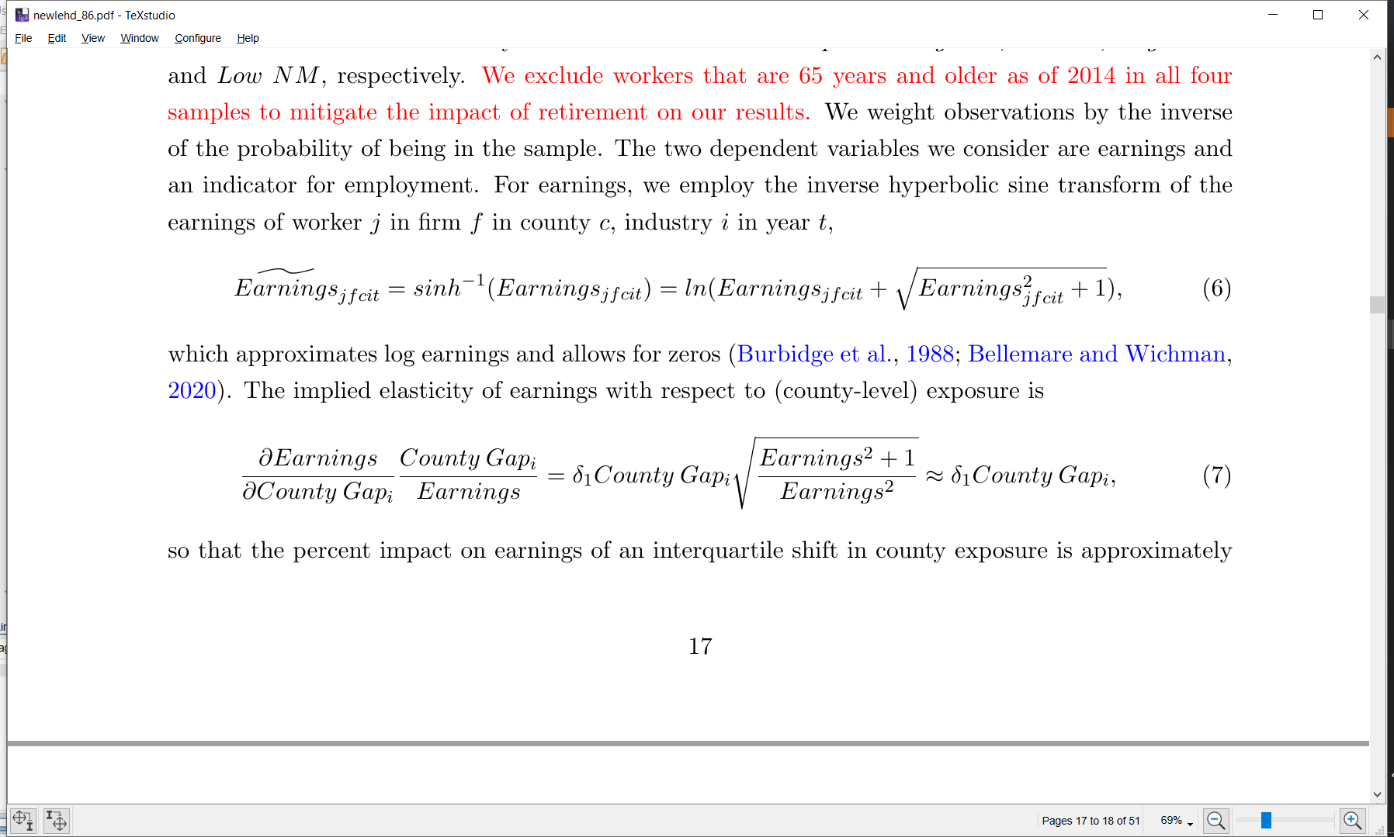
Earnings Outcomes worker j, firm f, county c, industry i, year t
Use (scale-dependent) arcsin transform to allow for zeros
Following best practice, also consider
Employment dummy, i.e., Earnings>0
ln(Earnings)
In our context, Earnings>0 and ln(Earnings) have natural interpretation of extensive and intensive margin, and arcsin is a combination of the two
(In disclosure: also use ln(Earnings+1), also natural in our context!)
ARC
LN
E>0

Slide 38
Specifications
“Direct” specification
Just consider own-industry and own-county exposure
“IO” specification
Also consider up- and downstream industry and county exposures

Slide 39

“Direct” Specification (1993-2014) worker j, firm f, county c, industry i, year t
${\tilde{Earnings}}_{jifct}$ = δ₁ $Post_{2001}$*NTR Gap_{i} + δ₂ $Post_{2001}$*NTR Gap_{c} + δ₃ $Post_{2001}$*X_{j}¹⁹⁹⁹ +
δ₄ $Post_{2001}$*X_{f}¹⁹⁹⁹ +
δ₅ $Post_{2001}MSH_{c,1999}$
α_{t} + α_{j} + ε_{fijct}
Exposure via initial industry of employment
Exposure via initial county of employment
Initial worker attributes (gender, race, education, age)
Initial firm attributes
(firm’s size, age and multi-unit status)
County c's 1999 manufacturing share
Year and worker FE
Notes:
MSH This term is a separate control for the prevalence of manufacturing in a county, thereby allowing the county exposure
term to reect exposure to PNTR conditional on the county's manufacturing share

Slide 40

“Direct” Specification (1993-2014) worker j, firm f, county c, industry i, year t
${\tilde{Earnings}}_{jifct}$ = δ₁ $Post_{2001}$*NTR Gap_{i} + δ₂ $Post_{2001}$*NTR Gap_{c} + δ₃ $Post_{2001}$*X_{j}¹⁹⁹⁹ +
δ₄ $Post_{2001}$*X_{f}¹⁹⁹⁹ +
δ₅ $Post_{2001}MSH_{c,1999}$
α_{t} + α_{j} + ε_{fijct}
Exposure via initial industry of employment
Exposure via initial county of employment
Initial worker attributes (gender, race, education, age)
Initial firm attributes
(firm’s size, age and multi-unit status)
County c's 1999 manufacturing share
Year and worker FE
Notes:
MSH This term is a separate control for the prevalence of manufacturing in a county, thereby allowing the county exposure
term to reect exposure to PNTR conditional on the county's manufacturing share

Slide 41
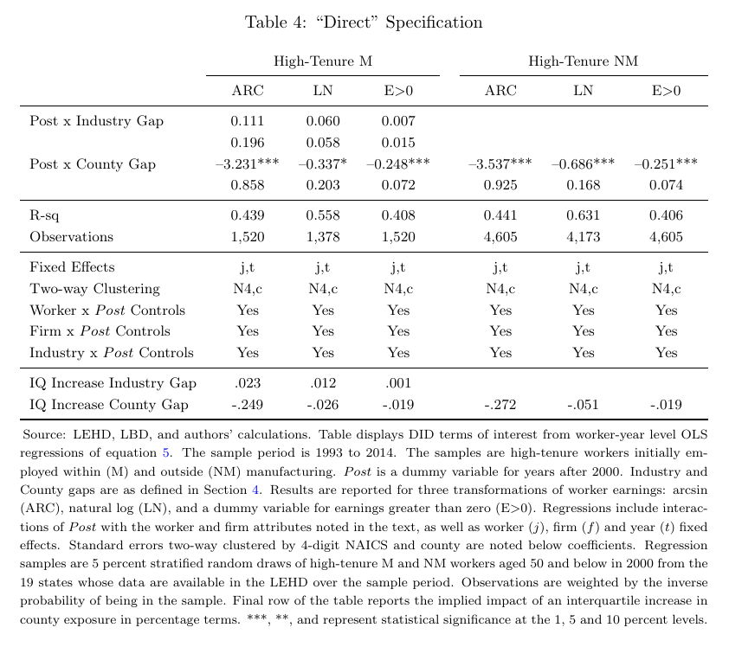
“Direct” Earnings DID Specification, by LHS Transformation 1993-2014
High-Tenure M
No impact of industry exposure
County exposure significant; suggests workers facing binding spatial relocation costs
Large declines in relative earnings associated with interquartile (IQ) increases in county exposure

Slide 42
“Direct” Earnings DID Specification, by LHS Transformation 1993-2014
High-Tenure M
High-Tenure NM
County exposure significant for both M and NM
Similar impact for M and NM

Slide 43
Literature?
Previous work by Autor et al. (2014) and Hakobyan and McLaren (2016) finds that both industry and location have a negative relationship with wages. Autor et al. (2014) also examine employment, and while they find a significant relationship only with spatial exposure, it is positive.
Our finding of a spillover between M and NM is consistent with Hakobyan and McLaren 2016 but different from Autor et al. (2013)’s region analysis, which finds that greater spatial exposure to imports from China reduces M but not NM employment, and decreases NM but not M wages.
More recent research by Bloom et al. (2019) finds that, depending on the time period and industrial classification system considered, greater spatial exposure to China can raise non-manufacturing employment. More on this below.

Slide 45
Timing?

Slide 46
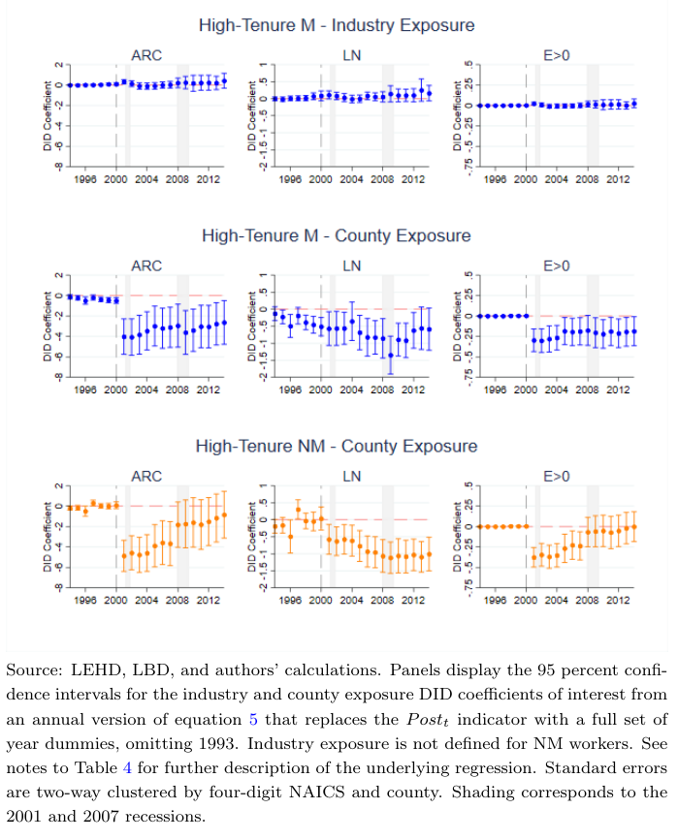

Slide 49
Outline
Introduction
Data
Reallocation after PNTR
PNTR and earnings: direct specification
PNTR and earnings: IO specification
Heterogenous impacts
Alternate specifications
Conclusion

Slide 50

IO Specification
Allow for exposure along the supply chain
E.g., upstream exposure
Industry: ${{Gap}_{i}}^{up}=\sum_{k}{{w_{ik}}^{up}}{Gap}_{i}$
County: ${{Gap}_{c}}^{up}=\sum_{i}{\frac{{L_{ic}}^{1990}}{{L_{c}}^{1990}}}{{Gap}_{i}}^{up}$
Analogous expressions for downstream
IO-coefficient (w) weighted average of all industries k that industry I buys from
Labor-weighted average upstream gap of all industries county c produces

Slide 51
Up- and Downstream Industry Exposure Manufacturing Highlighted, Medians Noted with Dashed Lines
Hospitals (622)
Textiles (313)
R&D (5417)

Slide 52
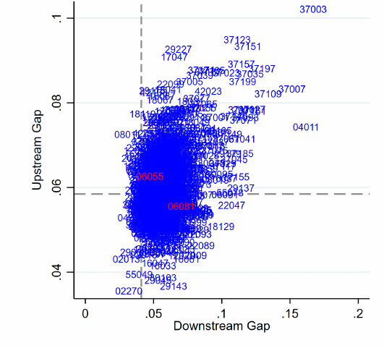
Up- and Downstream County Exposure Medians Noted with Dashed Lines
Napa (06055)
High Gap^{UP} (Health, Hotels, Retail, Wine)
Low Gap^{DN} (mostly consumers)
Santa Clara (06081)
Low Gap^{UP} (Software, Chem, Comp)
High Gap^{DN} (Electronics)

Slide 53
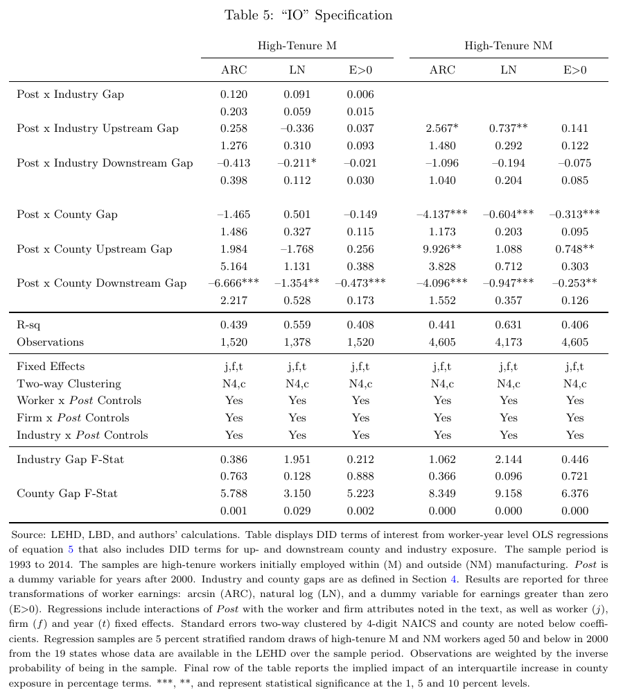
“IO” Specification
County exposure sign pattern as expected for overall and extensive margin
Industry exposure generally insignificant
County exposure significant as a group

Slide 54
“IO” Specification
For NM: large, positive upstream and large negative downstream coefficients

Slide 55
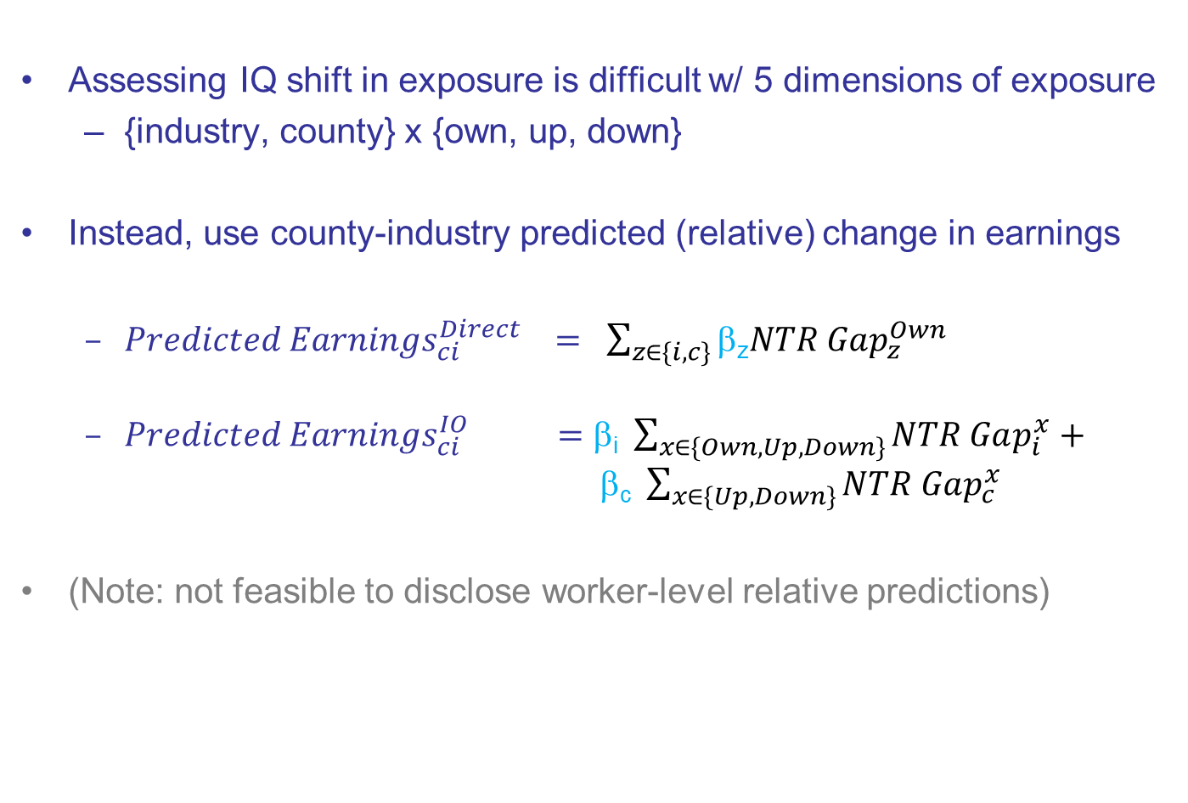
Economic Significance?
Assessing IQ shift in exposure is difficult w/ 5 dimensions of exposure
{industry, county} x {own, up, down}
Instead, use county-industry predicted (relative) change in earnings
${Predicted Earnings}_{ci}^{Direct} = \sum_{z∈\{i,c\}}{\text{b}\text{z}NTR Gap_{z}^{Own}}$
${Predicted Earnings}_{ci}^{IO} =\text{b}\text{i} \sum_{x∈\{Own,Up,Down\}}{NTR Gap_{i}^{x}}+$ $\text{b}\text{c} \sum_{x∈\{Up,Down\}}{NTR Gap_{c}^{x}}$
(Note: not feasible to disclose worker-level relative predictions)

Slide 56
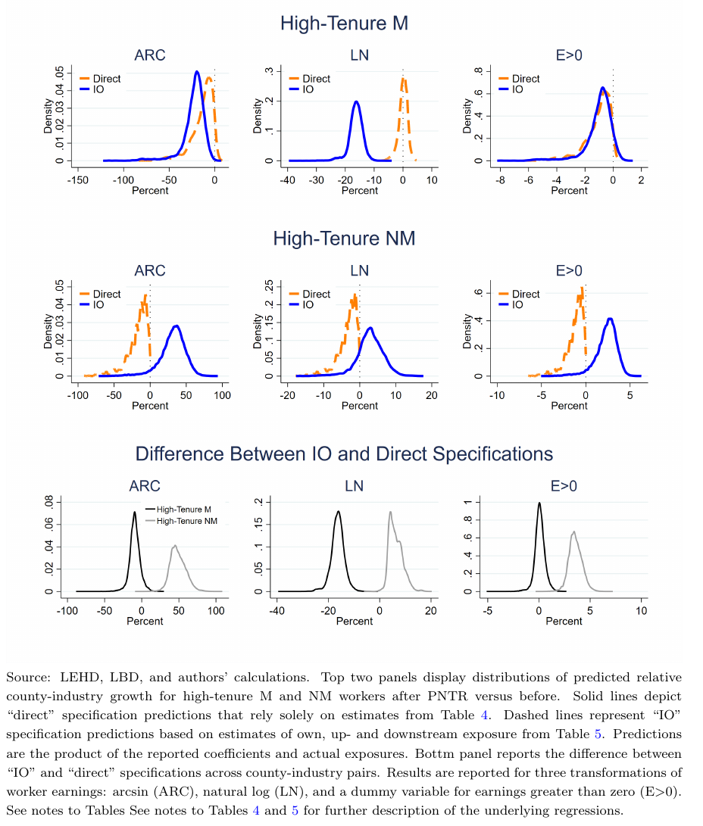
County-Industry Predicted (Relative) Earnings Growth
High-Tenure M
Each point in each distribution is a county-industry pair
The more left position of the “IO specification” indicates that relative earnings growth is over-predicted using the “direct” specification.
Message: supply chain linkages are important

Slide 57
County-Industry Predicted (Relative) Earnings Growth
High-Tenure M
Each point in each distribution is a county-industry pair
The more left position of the “IO specification” indicates that relative earnings growth is over-predicted using the “direct” specification.
Message: supply chain linkages are important
High-Tenure NM
Outside manufacturing, we see the opposite
The more right position of the “IO specification” indicates that relative earnings growth is under-predicted using the “direct” specification
This outcome is driven by upstream exposure

Slide 58
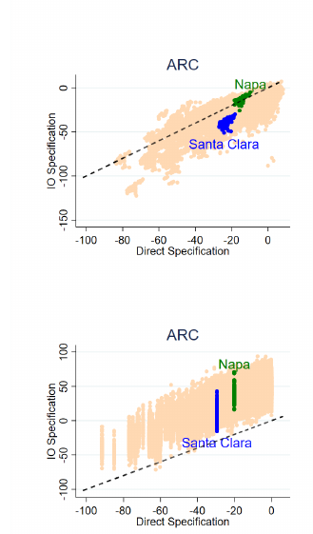
Intuition for Economic Significance
High-Tenure M
Napa: high upstream exposure, low downstream exposure
Santa Clara (Silicon Valley): low upstream, high downstream
So, M workers (county-industries) in Napa fare relatively well compared to M workers in Santa Clara
High-Tenure NM
NM workers (county-industries) fare relatively better in Napa vs Santa Clara, and more are predicted to have relative earnings growth

Slide 59
Results by Sample and Earnings Transformation
For M workers, the primary impact is along the intensive margin: lower earnings but no difference in remaining emplpyed.
Unions?

Slide 60
Results by Sample and Earnings Transformation
For M workers, the primary impact is along the intensive margin: lower earnings but no difference in remaining emplpyed.
Unions?

Slide 61
Results by Sample and Earnings Transformation
For M workers, the primary impact is along the intensive margin: lower earnings but no difference in remaining employed.
Unions?
For NM workers, outcomes are relatively better along both margins

Slide 62
Results by Sample and Earnings Transformation
The difference between these two distributions…
…is this distribution

Slide 63
Results by Sample and Earnings Transformation
IO Outcome Worse for M
IO Outcome Worse for M
IO Outcome Worse for M
IO Outcome Better for NM
IO Outcome Better for NM
IO Outcome Better for NM

Slide 64
Why Does M Do Relatively Worse Under “IO”
Several links of an M supply chain with various levels of exposure may move offshore together if productivity depends on proximity (Baldwin and Venables 2013).
In that case upstream exposure may offer no benefit, and downstream exposure is particularly disruptive.
For NM industries, such co-migration may not be possible, e.g., hospitals must stay within reach of their patients, and hotels must remain close to their guests.

Slide 65
Unions?
IO Outcome Worse for M
IO Outcome Worse for M
IO Outcome Better for NM
IO Outcome Better for NM
IO Outcome Worse for M
IO Outcome Better for NM
For M, overall (relative) decline driven almost entirely by intensive margin.
For NM, overall (relative) gains occur along both margins

Slide 66
Outline
Introduction
Data
Reallocation after PNTR
PNTR and earnings: direct specification
PNTR and earnings: IO specification
PNTR and worker attributes
Conclusion

Slide 67
Triple Interaction DID
Amend specification above to interact all 6 exposures with an initial worker attribute
In separate regressions, consider
Female vs male
Below age 30 or above
At least bachelors degree or not
Non-white vs white
Q4 earnings vs not
Worker at small vs large firm
Worker at trading vs non-trading firm
Worker at diversified vs non-diversified firm
Plot predicted relative earnings for each group, as in above figures
Are firm characteristics important for worker outcomes?

Slide 68
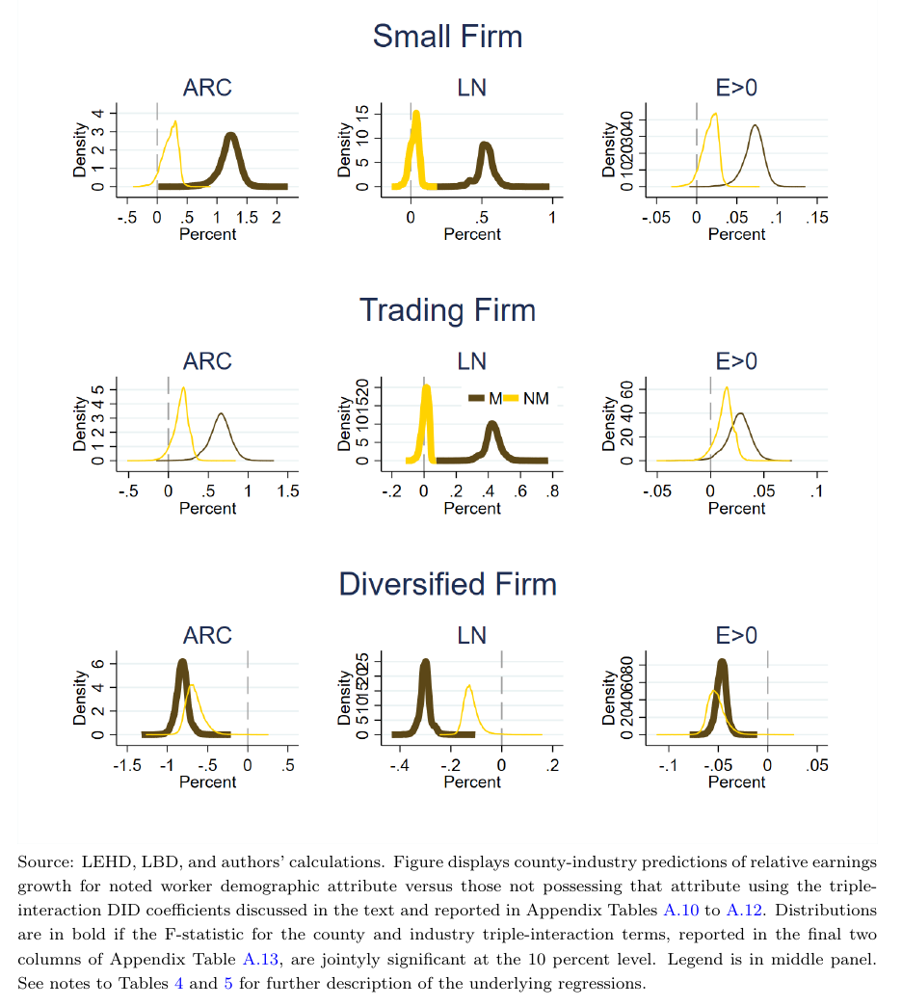
Triple Interaction DID
M workers at initially small firms have higher predicted relative earnings than workers at initially large firms. First worker-level evidence consistent with Holmes and Stevens (2014)

Slide 69
Triple Interaction DID
M workers at initially small firms have higher predicted relative earnings than workers at initially large firms. First worker-level evidence consistent with Holmes and Stevens (2014)
M workers at diversified firms (have both M and NM) do relatively worse
Surprising? Might think these workers have better ability to switch sectors?
Or, maybe relates to Holmes and Stevens (2014)

Slide 70
Triple Interaction DID
M workers at initially small firms have higher predicted relative earnings than workers at initially large firms. First worker-level evidence consistent with Holmes and Stevens (2014)
M workers at diversified firms (have both M and NM) do relatively worse
Surprising? Might think these workers have better ability to switch sectors?
Or, maybe relates to Holmes and Stevens (2014)
Some evidence that M workers fare relatively better at trading firms

Slide 71
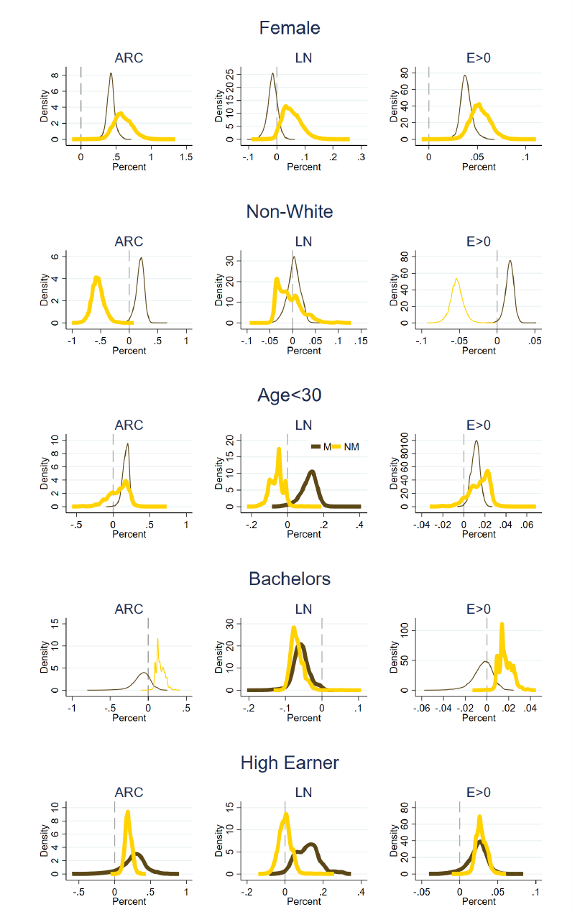
Females have predicted relative earnings gains versus males in NM
Strongest result: initial high earners in both M and NM have relatively higher earnings than low earners. More transferable human capital? Greater ability to be more selective in accepting a new job due to savings?

Slide 72
Outline
Introduction
Data
Reallocation after PNTR
PNTR and earnings: direct specification
PNTR and earnings: IO specification
PNTR and worker attributes
Robustness to low-tenure workers, alternate county exposure
Conclusion

Slide 73
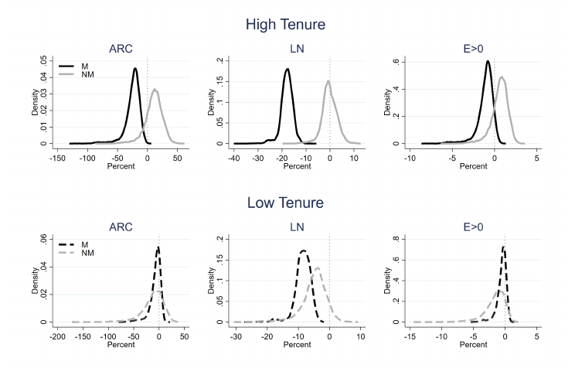
High vs Low Tenure

Slide 74
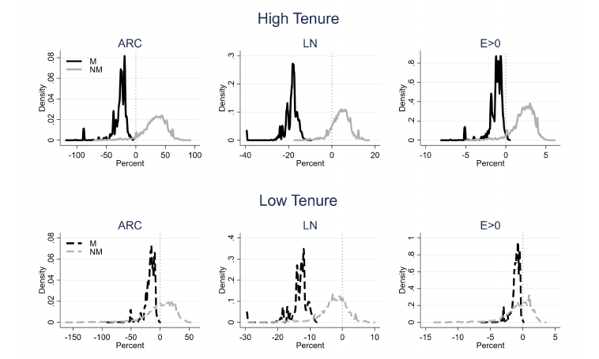
Alternate County Exposure

Slide 75
Outline
Introduction
Data
Reallocation after PNTR
PNTR and earnings: direct specification
PNTR and earnings: IO specification
PNTR and worker attributes
Robustness to low-tenure workers, alternate county exposure
Conclusion

Slide 76
Conclusions
County exposure matters more than industry exposure
Upstream exposure mitigates own and downstream exposure
Exposed M workers exhibit substantial losses in relative earnings
NM workers with upstream exposure exhibit relative gains

Slide 77
Thanks!

